Slide 1
THE 12 MINOR PROPHETS
An overview of the timeline

Slide 2
Joshua 24:14-15 choose this day who you will serve!
14 “Now therefore fear the Lord and serve him in sincerity and in faithfulness. Put away the gods that your fathers served beyond the River and in Egypt, and serve the Lord.
15 And if it is evil in your eyes to serve the Lord, choose this day whom you will serve, whether the gods your fathers served in the region beyond the River, or the gods of the Amorites in whose land you dwell. But as for me and my house, we will serve the Lord.”

Slide 3
Judges 17:6
6 In those days there was no king in Israel. Everyone did what was right in his own eyes.

Slide 4
Everyone Needs Program
Time overview from 1000 feet

Slide 5
Event | Year
Promise to Abraham | 1925 BC
Joseph’s Family in Egypt | 1700 BC
Moses Leading the people out of Egypt | 1280 BC
Joshua Leading the people into the promised land | 1240 BC
People ruled by “judges” | 1220 BC
People ruled by kings (all tribes together) | 1050 BC
Kingdom split into Northern and Southern Kingdom’s | 93o BC
Northern Kingdom conquered | 722 BC
Southern Kingdom exiled | 586 BC
Remnant back in Jerusalem | 538 BC
Old Testament ends with 400 silent years | 420 BC
The Greg Disclaimer….all these dates have an “ish” attached!

Slide 6
Event | Year
Promise to Abraham | 1925 BC
Joseph’s Family in Egypt | 1700 BC
Moses Leading the people out of Egypt | 1280 BC
Joshua Leading the people into the promised land | 1240 BC
People ruled by “judges” | 1220 BC
People ruled by kings (all tribes together) | 1050 BC
Kingdom split into Northern and Southern Kingdom’s | 93o BC
Northern Kingdom conquered | 722 BC
Southern Kingdom exiled | 586 BC
Remnant back in Jerusalem | 538 BC
Old Testament ends with 400 silent years | 420 BC
12 minor prophets cover time from about 800 BC to about 400 BC

Slide 7
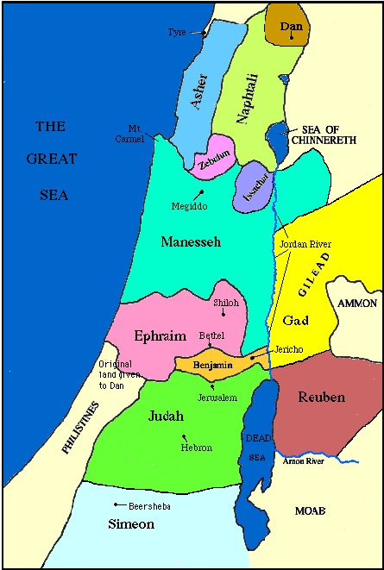

Slide 8
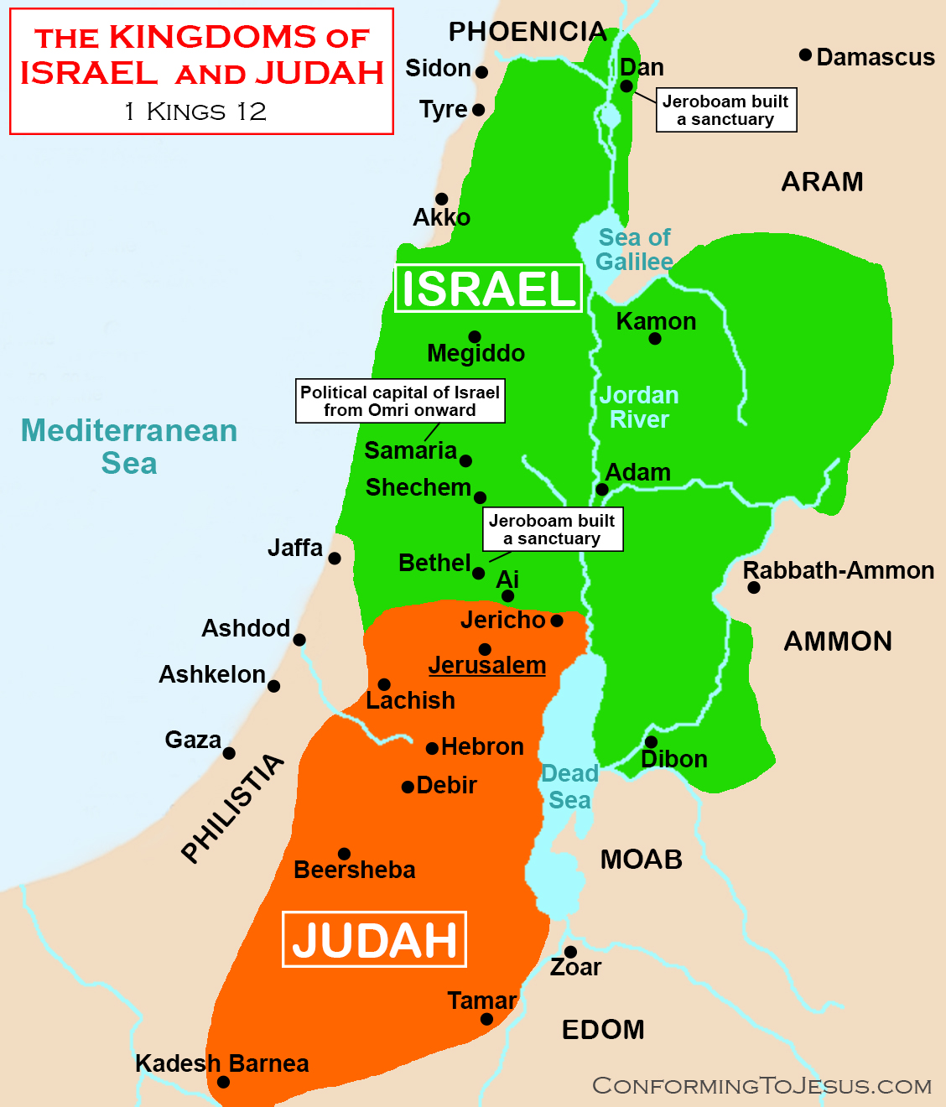

Slide 10
MORE REASONS TO NEED A PROGRAM
Traditional Division
Division According to Land
Reuben
Simeon
Levi
Judah
Issachar
Zebulun
Dan
Naphtali
Gad
Asher
Joseph
Benjamin
Reuben
Simeon
Judah
Issachar
Zebulun
Dan
Naphtali
Gad
Asher
Benjamin
Ephraim (son of Joseph)
Manasseh (son of Joseph)

Slide 11
Prophets split into Captive Periods
Assyrian Period
Jonah (790 – 770)
Joel (790 – 770)
Amos (780 – 740
Hosea (760 – 720)
ISAIAH (745 – 695)
Micah (740 – 700)
Zephaniah (639 – 608)
Nahum (630 – 610)
Babylonian Period
JEREMIAH (626 – 586)
Habakkah (606 – 586)
EZEKIAL (592 – 570)
Obadiah (586 – 583
DANIEL (605 – 534)
Persian Period
Haggai (520 – 516)
Zechariah (520 – 516)
Malachi (450 – 400)

Slide 12
The Promise of Disobedience
Spoken by Moses…and the prophets…just as the Lord said!

Slide 13
Leviticus 26
¹⁴ “‘But if you will not listen to me and carry out all these commands, ¹⁵ and if you reject my decrees and abhor my laws and fail to carry out all my commands and so violate my covenant,
¹⁶ then I will do this to you: I will bring on you sudden terror, wasting diseases and fever that will destroy your sight and sap your strength. You will plant seed in vain, because your enemies will eat it.
¹⁷ I will set my face against you so that you will be defeated by your enemies; those who hate you will rule over you, and you will flee even when no one is pursuing you.

Slide 14
Leviticus 26
¹⁸ “‘If after all this you will not listen to me, (then) I will punish you for your sins seven times over.
¹⁹ I will break down your stubborn pride and make the sky above you like iron and the ground beneath you like bronze.
²⁰ Your strength will be spent in vain, because your soil will not yield its crops, nor will the trees of your land yield their fruit.

Slide 15
Leviticus 26
²¹ “‘If you remain hostile toward me and refuse to listen to me, (then) I will multiply your afflictions seven times over, as your sins deserve.
²² I will send wild animals against you, and they will rob you of your children, destroy your cattle and make you so few in number that your roads will be deserted.

Slide 16
Leviticus 26
²³ “‘If in spite of these things you do not accept my correction but continue to be hostile toward me,
(then) ²⁴ I myself will be hostile toward you and will afflict you for your sins seven times over.
²⁵ And I will bring the sword on you to avenge the breaking of the covenant. When you withdraw into your cities, I will send a plague among you, and you will be given into enemy hands.
²⁶ When I cut off your supply of bread, ten women will be able to bake your bread in one oven, and they will dole out the bread by weight. You will eat, but you will not be satisfied.

Slide 17
Leviticus 26
²⁷ “‘If in spite of this you still do not listen to me but continue to be hostile toward me,
²⁸ then in my anger I will be hostile toward you, and I myself will punish you for your sins seven times over.
²⁹ You will eat the flesh of your sons and the flesh of your daughters.
³⁰ I will destroy your high places, cut down your incense altars and pile your dead bodies on the lifeless forms of your idols, and I will abhor you.
³¹ I will turn your cities into ruins and lay waste your sanctuaries, and I will take no delight in the pleasing aroma of your offerings.
Notes:
Read notes first!
Then finally 27 through 39

Slide 18
Leviticus 26 – (If in spite of this you still do not listen to me…)
^{(then) 32} I myself will lay waste the land, so that your enemies who live there will be appalled.
³³ I will scatter you among the nations and will draw out my sword and pursue you. Your land will be laid waste, and your cities will lie in ruins.
³⁴ Then the land will enjoy its sabbath years all the time that it lies desolate and you are in the country of your enemies; then the land will rest and enjoy its sabbaths.
³⁵ All the time that it lies desolate, the land will have the rest it did not have during the sabbaths you lived in it.

Slide 19
Leviticus 26 – (If in spite of this you still do not listen to me…)
^{(then) 36} “‘As for those of you who are left, I will make their hearts so fearful in the lands of their enemies that the sound of a windblown leaf will put them to flight. They will run as though fleeing from the sword, and they will fall, even though no one is pursuing them.
³⁷ They will stumble over one another as though fleeing from the sword, even though no one is pursuing them. So you will not be able to stand before your enemies.
³⁸ You will perish among the nations; the land of your enemies will devour you.
³⁹ Those of you who are left will waste away in the lands of their enemies because of their sins; also because of their ancestors’ sins they will waste away.

Slide 20
Leviticus 26
⁴⁰ “‘But if they will confess their sins and the sins of their ancestors—their unfaithfulness and their hostility toward me, ⁴¹ which made me hostile toward them so that I sent them into the land of their enemies—then when their uncircumcised hearts are humbled and they pay for their sin,
(then) ⁴² I will remember my covenant with Jacob and my covenant with Isaac and my covenant with Abraham, and I will remember the land.

Slide 21
Leviticus 26
⁴³ For the land will be deserted by them and will enjoy its sabbaths while it lies desolate without them. They will pay for their sins because they rejected my laws and abhorred my decrees.
⁴⁴ Yet in spite of this, when they are in the land of their enemies, I will not reject them or abhor them so as to destroy them completely, breaking my covenant with them. I am the Lord their God.
⁴⁵ But for their sake I will remember the covenant with their ancestors whom I brought out of Egypt in the sight of the nations to be their God. I am the Lord.’”

Slide 22
Leviticus 26
⁴⁶ These are the decrees, the laws and the regulations that the Lord established at Mount Sinai between himself and the Israelites through Moses.

Slide 23
2 Chronicles 7:14
14 If my people, which are called by my name, shall humble themselves, and pray, and seek my face, and turn from their wicked ways; then will I hear from heaven, and will forgive their sin, and will heal their land.

Slide 24
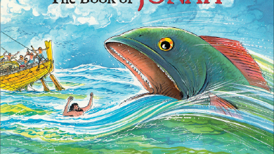
First up: Jonah

